Slide 1
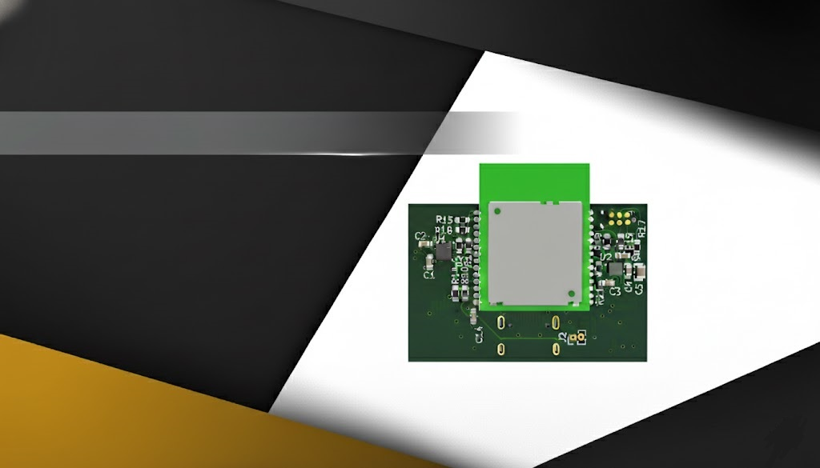

Design of a Wireless Indoor Tracking System for Multi-Sensor Data Acquisition with BLE Channel Sounding
Name: Vasiloglou Athanasios
Advisor: Prof. Evangelos V. Hristoforou, NTUA
Date: 24/10/2025
ECE
NTUA

Slide 2
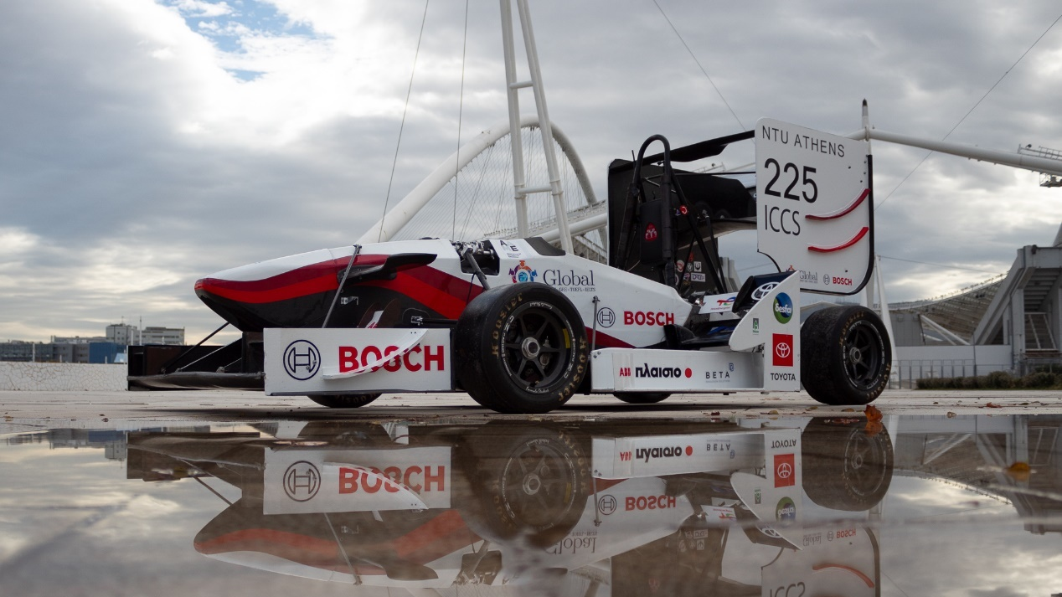
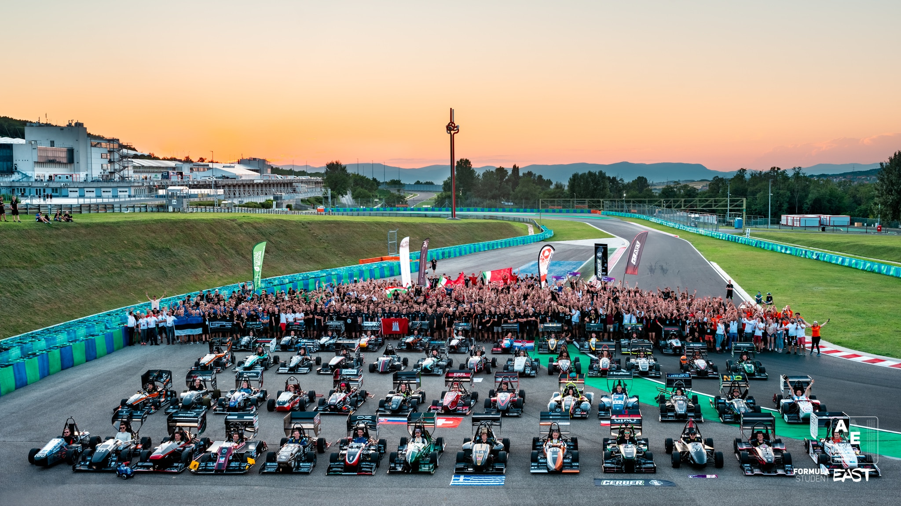
Introduction
2
Formula Student

Slide 3
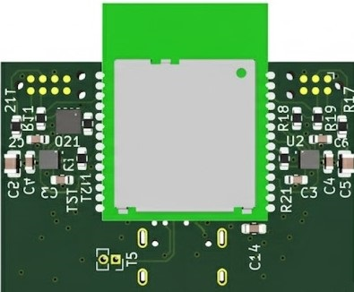
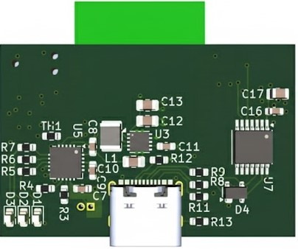
Hardware Design
Q&A

Slide 4
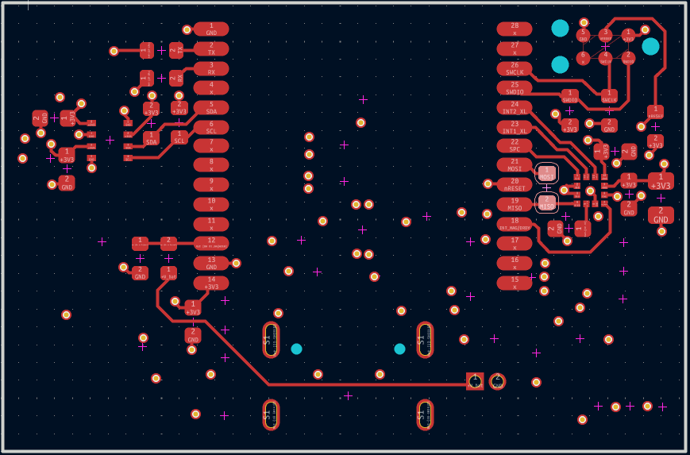
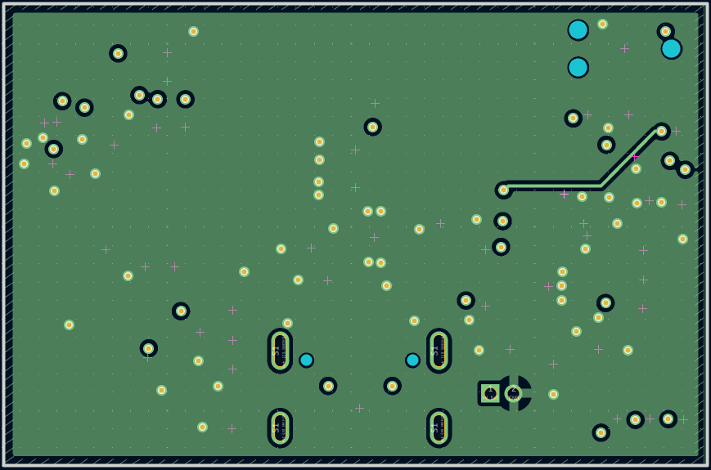
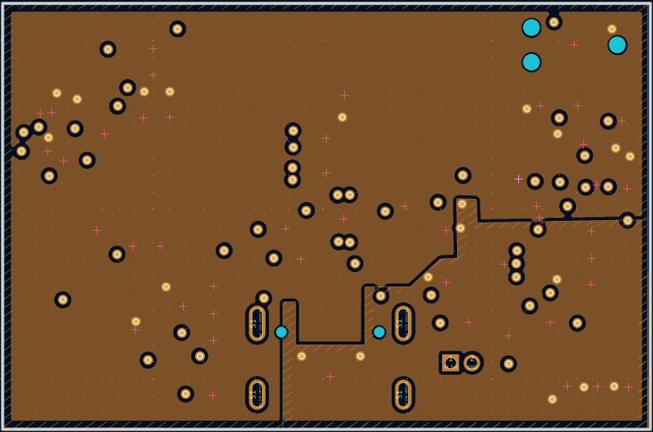
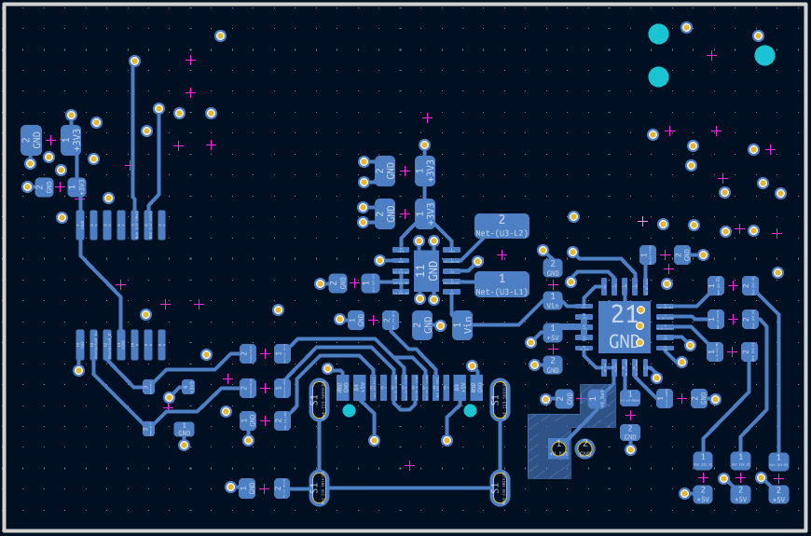
Hardware Design
4
PCB Stack Up
Top layer
Signals
ME54BS01 module
Sensors
First inner layer
Ground
Second inner layer
Power Plane
3V3
5V
Bottom layer
Power Management
USB Differential Pair
Q&A

Slide 5
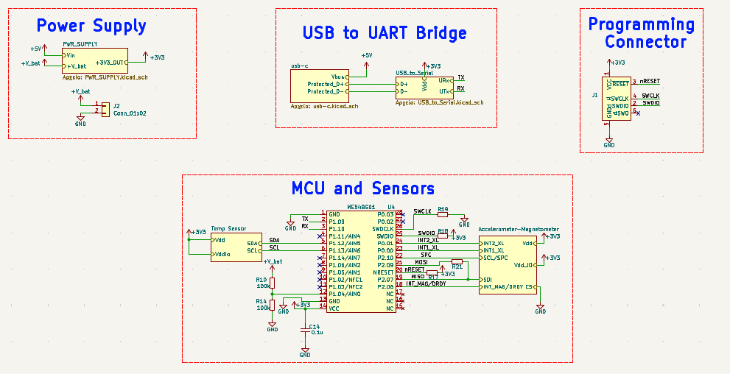
Schematic Diagram
5
Q&A

Slide 6
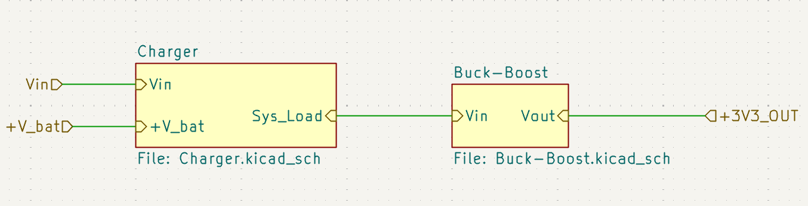
Power Supply
6
Q&A

Slide 7
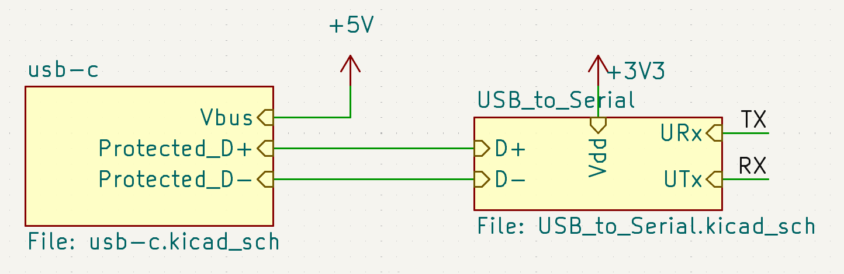
UART – USB Bridge
7
Q&A

Slide 8
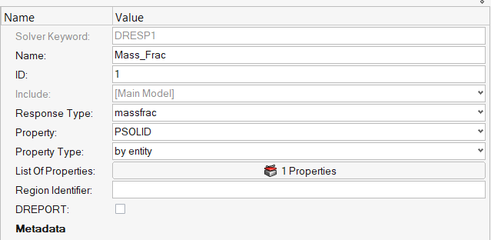
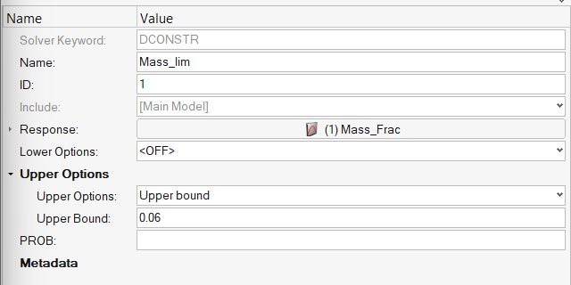
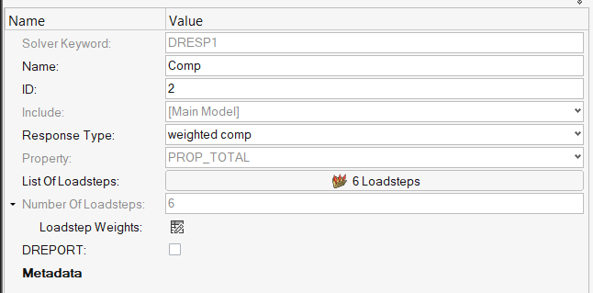
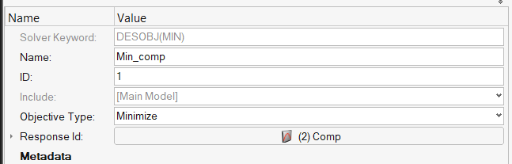
Topology Optimization
8
Analysis Set Up
Constraints Card
Responsis Card
Objective Card
Q&A

Slide 9
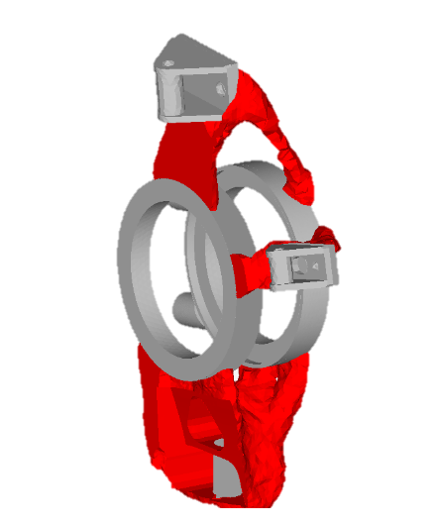
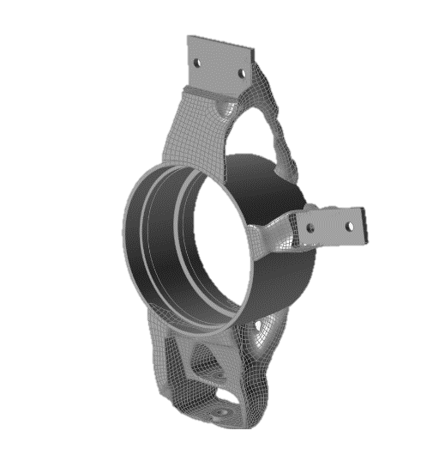
Topology Optimization
9
Results
Iso surfaces
Inspire Polynurbs Function
Q&A

Slide 10
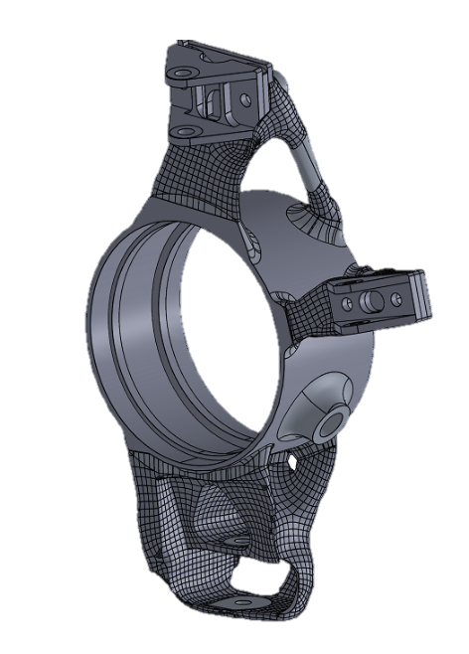
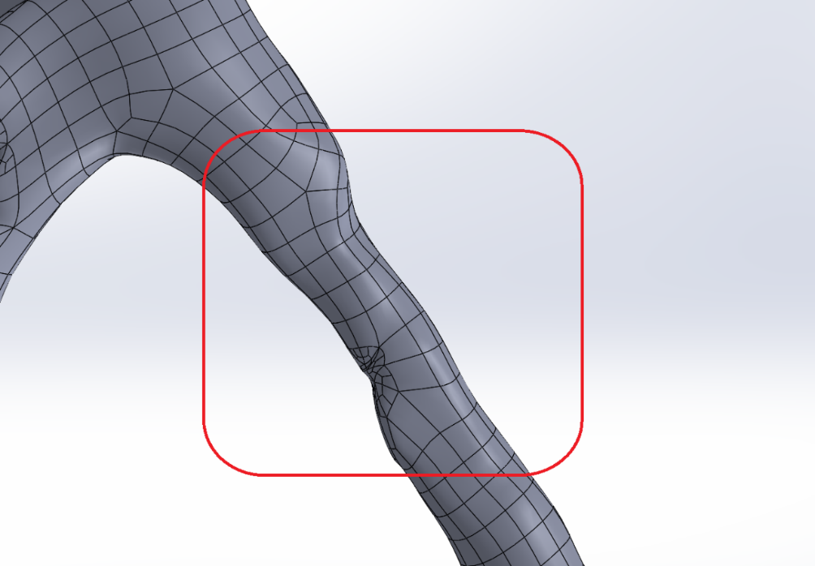
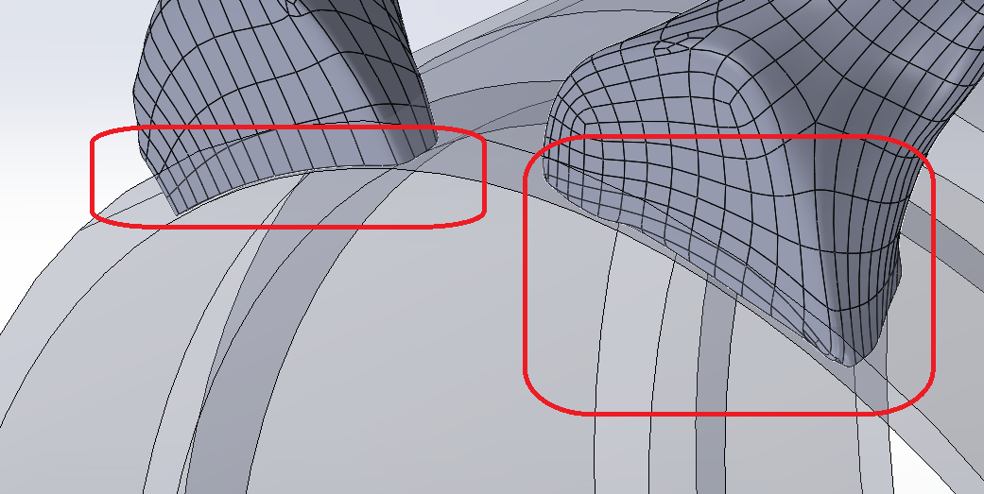
Topology Optimization
10
Detailed CAD and Calculation
Caliper’s Thread
Bearings Tolerances
Hall sensor mounting
Invalid and problematic Geometries
Q&A

Slide 11
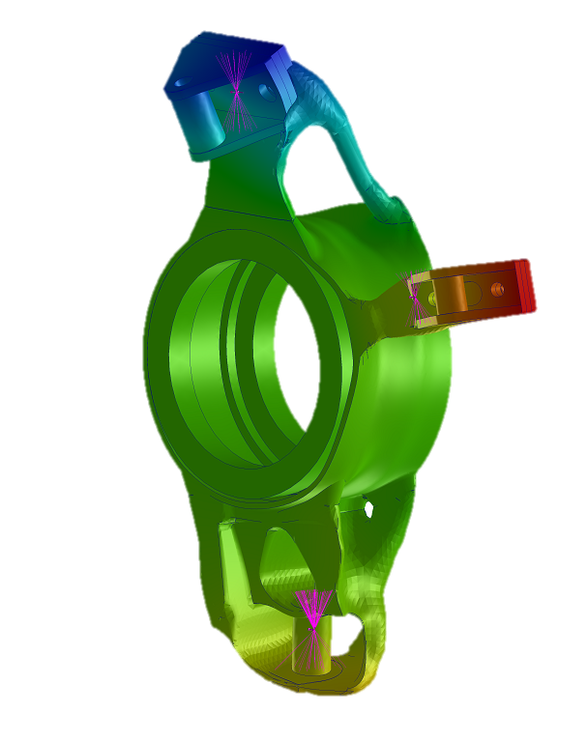
Weight : 259 gr
Camber Compliance : 0.0224 deg/g
Toe Compliance : 0.0176 deg/g Max Von misses: 170 Mpa
Topology Optimization
11
Validation FEA Set Up
Q&A

Slide 12
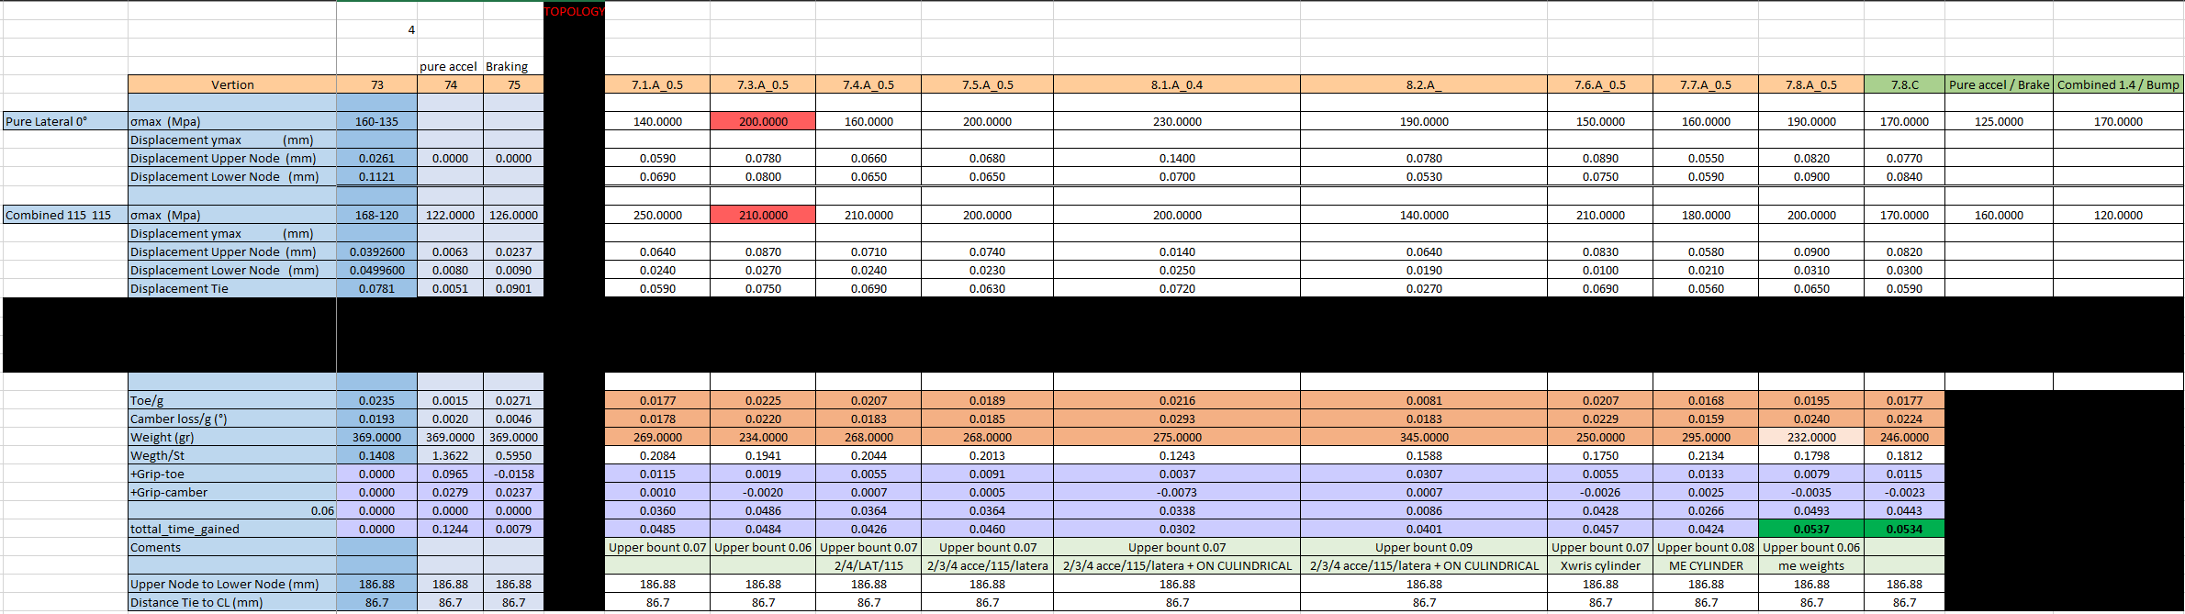
Topology Optimization
12
Comparison Tool
1g Loss
1 deg/g stiffer in Camber
1 deg/g stiffer in Toe
0.00018% Grip Gain
0.73% Grip Gain
2% Grip Gain
Q&A

Slide 13
Topology Optimization
13
Comparison Tool

Slide 14
Topology Optimization
14
Comparison Tool

Slide 15
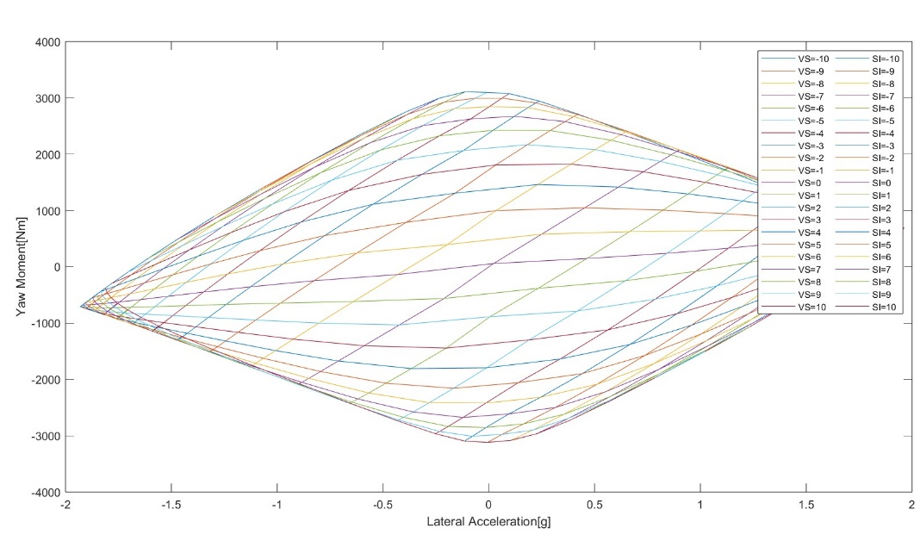
Yaw Moment Method
15
Yaw Moment Diagrams and Skid Pad Competition
5. Course Exit
4. Two counter-clockwise laps
2. Two clockwise laps
3. Transmission
1. Course Entry
Yaw Moment for different inputs
Skidpad
Q&A

Slide 16
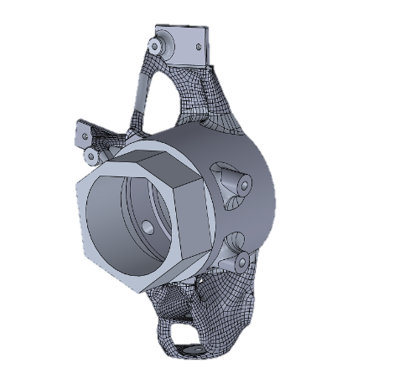
Additive Manufacturing With SLM
16
Final Geometry based on manufacturing needs
SLM Design
Smaller hole diameter
Extra matirial on imporatnt surfaces
Hexagonal jig
Q&A

Slide 17
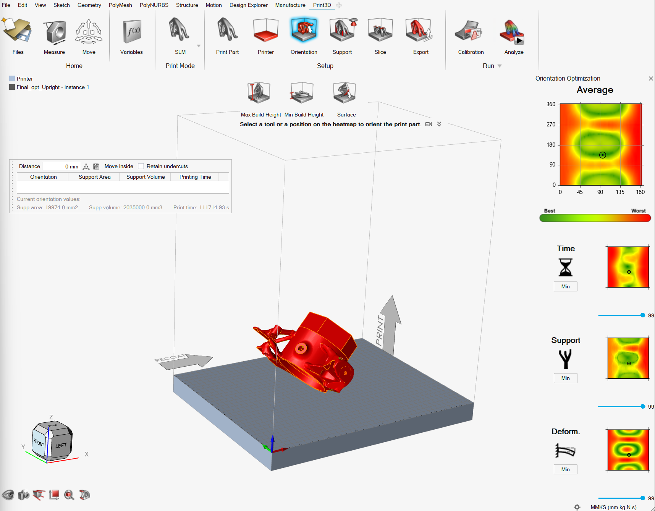
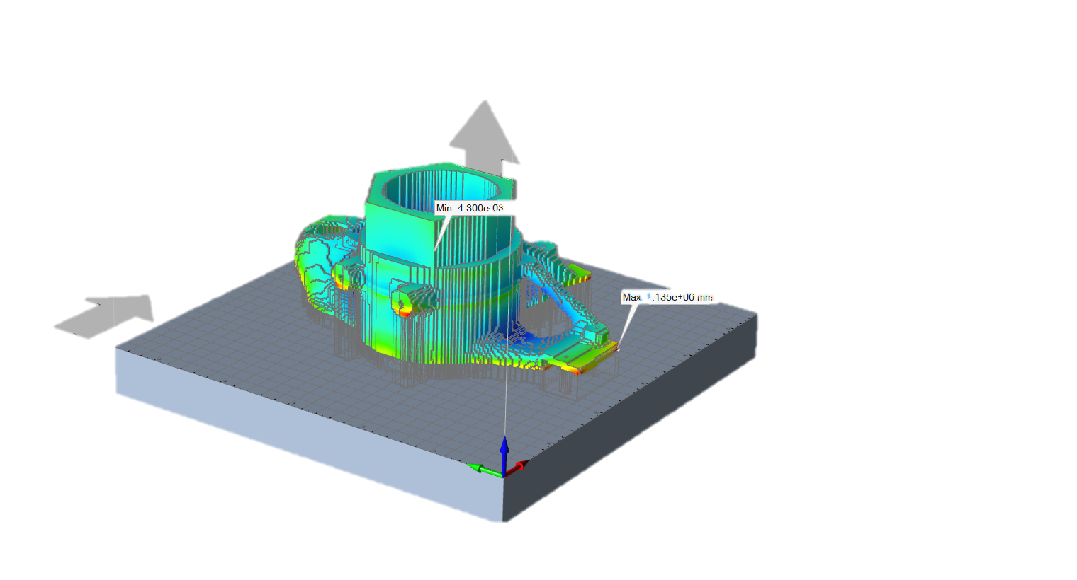
Additive Manufacturing With SLM
17
Thermo-Mechanical Analysis
SLM Simulation
Orientation
Matirial
Supports
Laser power
Powder thicknes
Q&A

Slide 18
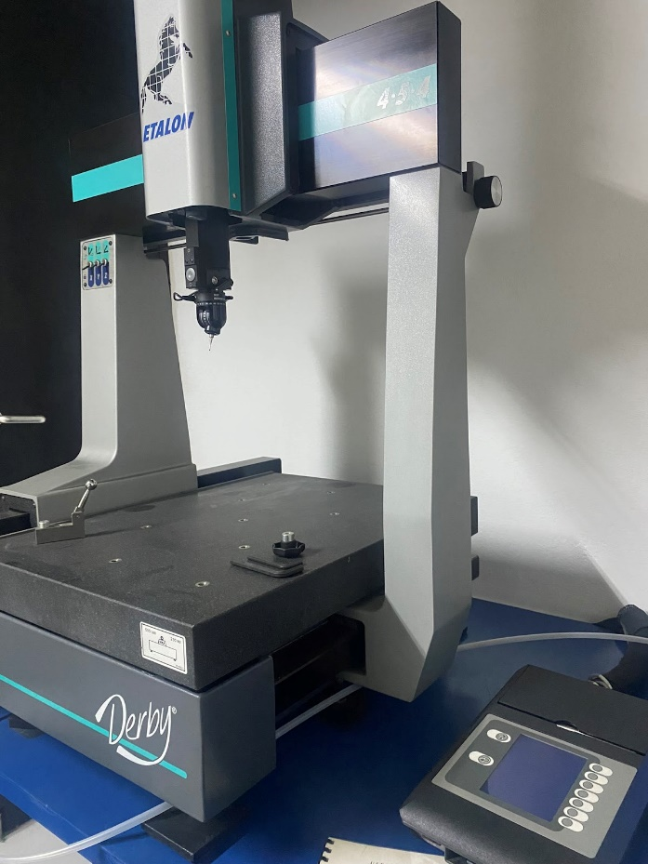
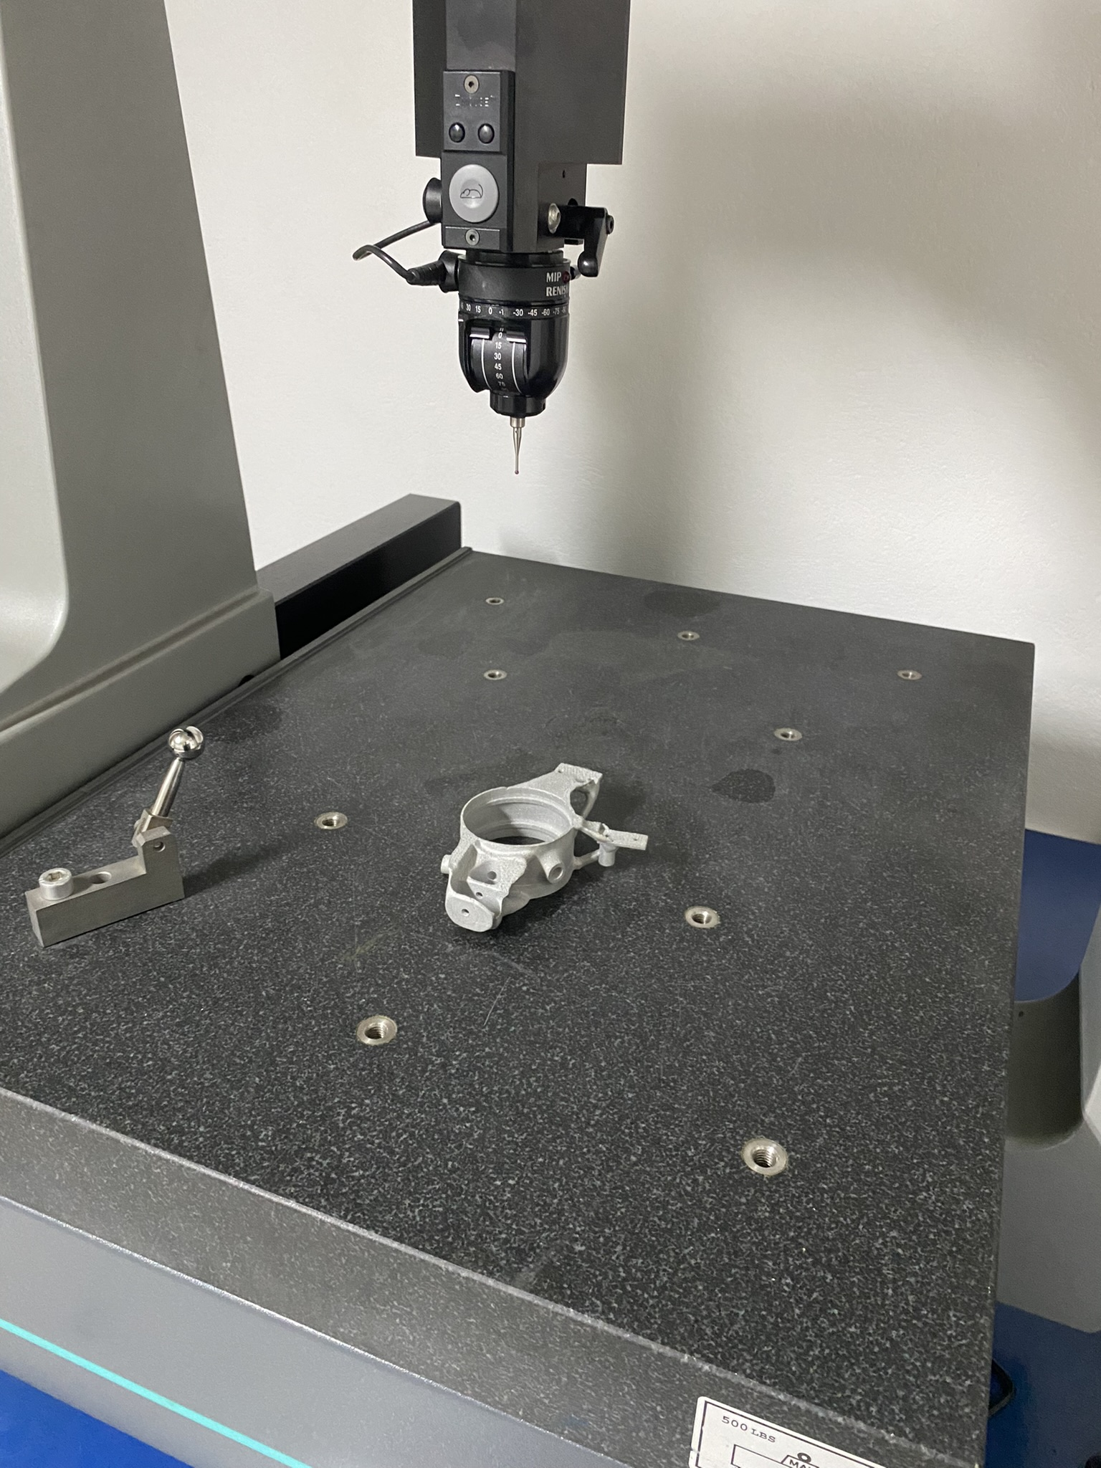
Additive Manufacturing With SLM
18
Dimensional Measurements CMM
Hole dimension accuracy of 0.342 m
Feature relative position tolerance of 0.236 mm
Flatness of 0.103 mm
Circularity of 0.160 mm
The planes were aligned within 1 degree
of the desired inclination
Q&A

Slide 19
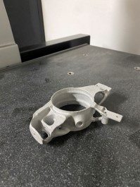
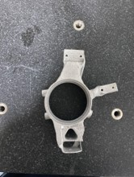
19
Conclusions and Perspectives
19
Results
Summary
Topology and SLM guide
Enhanced Vehicle Performance
Efficiency in Manufacturing
Prom Racing Literature
Further Work
Test on different parameters
SLM Fatigue
Parts with Lattice core
Q&A
19

Slide 20
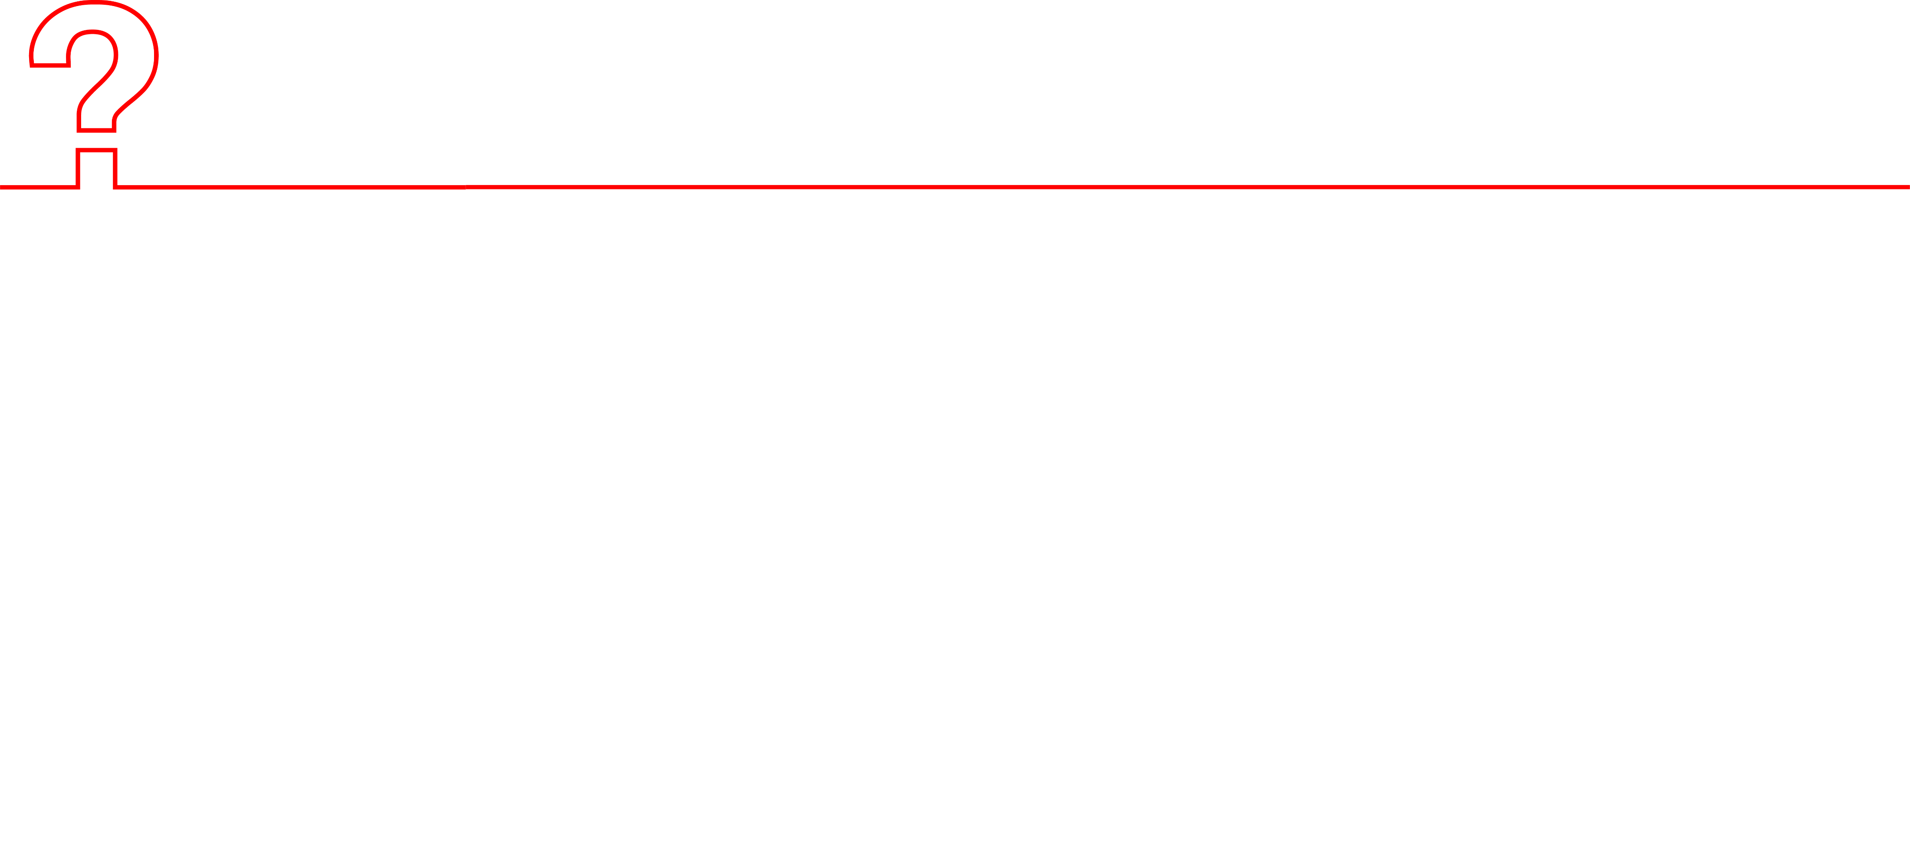
Thanks for your Attention!
20
Q&A
Upright Conventional Design
P22 σελ.3
FEA Set Up σελ.4
YAW Moments Methods
Yaw Moment Diagrams & SkidPad Competition σελ.15
Topology Optomization
Design Space Definition σελ.5
Load cases scenario σελ.6
Hyperworks topology set up σελ.7
Analysis Set Up σελ.8
Results σελ. 9
CAD & Calculations σελ.10
Validation FEA Set Up σελ.11
Comparison Tool σελ.12
Additive Manufacturing With SLM
Final Geometry based on manufacturing needs σελ.16
Thermo-Mechanical Analysis σελ.17
Dimensional Measurements CMM σελ.18
CONCLUSIONS & PERSPECTIVES

